Slide 1
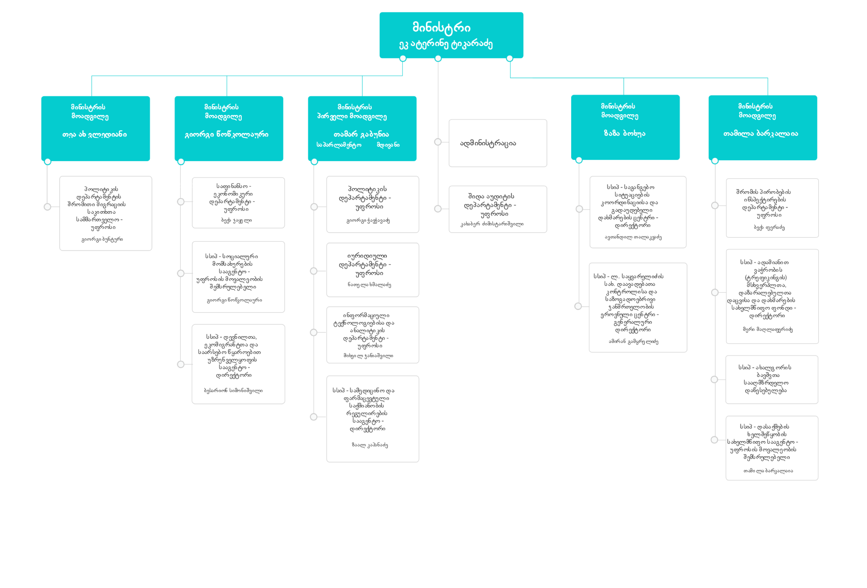

Slide 2
Minister of Internally Displaced Persons from Occupied Territories, Labour, Health and Social Affairs
First Deputy Minister
Parliamentary Secretary
Deputy Minister
Deputy Minister
Deputy Minister
Policy Department
Department of Labor Inspection
Administration
Department of Finance and Economics"
Labor Migration Division
Department of Policy
Legal Department
ადამიანით ვაჭრობის (ტრეფიკინგის) მსხვერპლთა, დაზარალებულთა დაცვისა და დახმარების სახელმწიფო ფონდი
LEPL „Social Services Agency“
Internal Audit
Department of Information Technology and Analytics
LEPL L. Sakvarelidze National Center for Disease Control and Public Health"
საგანგებო სიტუაციების კოორდინაციისა და გადაუდებელი დახმარების ცენტრი
LEPL Medical and Pharmaceutical Activities Regulation Agency
LEPL “State Employment Promotion Agency”
LEPL IDP Livelihood Agency
LEPL L. Sakvarelidze National Center for Disease Control and Public Health"
Coordination of implementation of Public Health State Programs and Global Fund projects
LEPL “Akhalgori Children's Educational Institution

